Slide 1
Software Quality Engineering
Lecture 1
Part II-software testing
Structural testing
alina.arshad@nu.edu.pk

Slide 2
SLICE BASED TESTING
we prepare various subsets (called slices) of a program with respect to its variables and their selected locations in the program.
Each variable with one of its location will give us a program slice.
A large program may have many smaller programs (its slices), each constructed for different variable subsets.
“Program slicing is a technique for restricting the behavior of a program to some specified subset of interest. A slice S(v, n) of program P on variable , or set of variables, at statement n yields the portions of the program that contributed to the value of just before statement n is executed. S (v, n) is called a slicing criteria.
Slices can be computed automatically on source programs by analyzing data flow.
Only two things are important here, variable and its selected location in the program.

Slide 3
Guidelines for Slicing
All statements where variables are defined and redefined should be considered.
All statements where variables receive values externally should be considered.
All statements where output of a variable is printed should be considered.
The status of all variables may be considered at the last statement of the program.

Slide 4
Creation of Program Slices
Consider the portion of a program given in Figure 4.2 for the identification of its slices.
a = 3;
b = 6;
c = b²;
d = a²+ b²;
c = a + b;

Slide 5
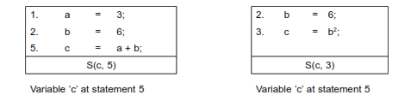
Program slices
We identify two slices for variable ‘c’ at statement number 3 and statement number 5.

Slide 6
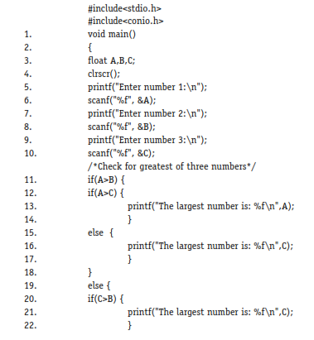
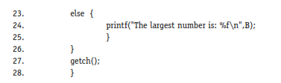
Example: find the largest number amongst three numbers.

Slide 7
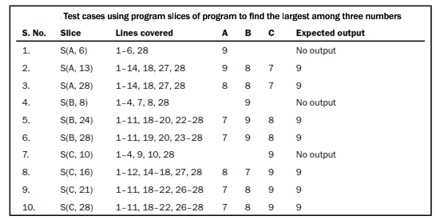
Test cases

Slide 8
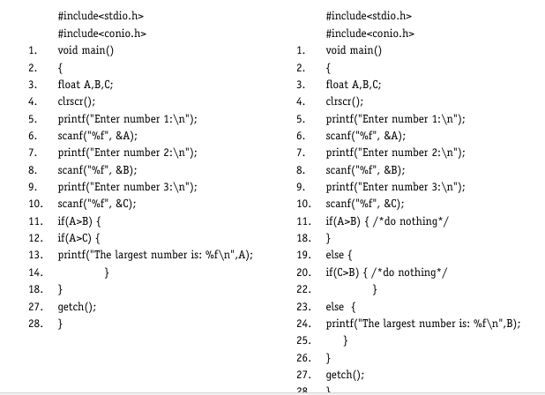
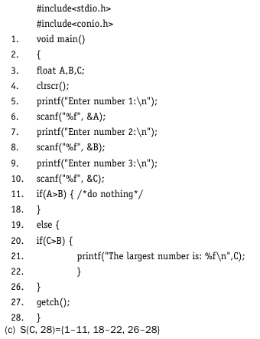

Slide 9
Limitations of slice-based testing
Slice based testing is a popular structural testing technique and focuses on a portion of the program with respect to a variable location in any statement of the program.
Hence slicing simplifies the way of testing a program’s behaviour with respect to a particular subset of its variables.
But slicing cannot test a behaviour which is not represented by a set of variables or a variable of the program.

Slide 10
#include <stdio.h>
#include <conio.h>
void main() {
float A, B, C;
clrscr();
printf("Enter number 1:\n");
scanf("%f", &A);
printf("Enter number 2:\n");
scanf("%f", &B);
printf("Enter number 3:\n");
scanf("%f", &C);
if (A > B) {
if (A > C) {
printf("The largest number is: %f\n", A);
} else {
printf("The largest number is: %f\n", C);
}
} else {
if (B > C) {
printf("The largest number is: %f\n", B);
} else {
printf("The largest number is: %f\n", C);
}
}
getch();
}

